Slide 1
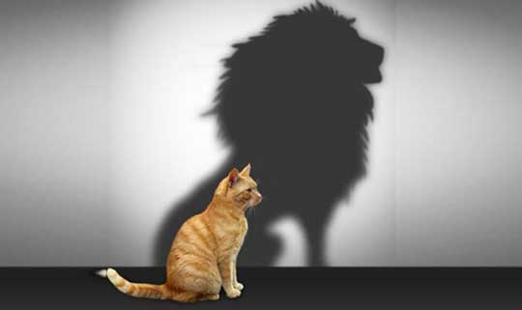
Our Position in Christ
Soteriology: God’s Rescue Program
Dr. Rick Griffith • Jordan Evangelical Theological Seminary • BibleStudyDownloads.org

Slide 2
Do we teach about our position in Christ today?
Not much.
Instead, we emphasize…

Slide 3

Self Esteem

Slide 4

THE LADDER OF SELF ESTEEM
YES, I DID IT!
I WILL DO IT
I CAN DO IT
I'LL TRY TO DO IT
HOW DO I DO IT?
I WANT TO DO IT
I CAN'T DO IT
I WON'T DO IT
Notes:
NS-Rom5-8-Slide 42
SA-07-Position in Christ-4

Slide 5

Self Esteem

Slide 6

Self Esteem

Slide 7
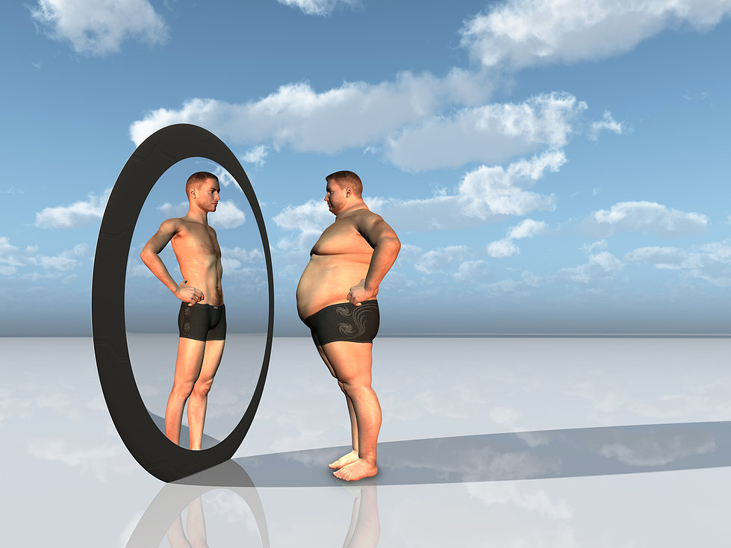
High Self Esteem

Slide 8
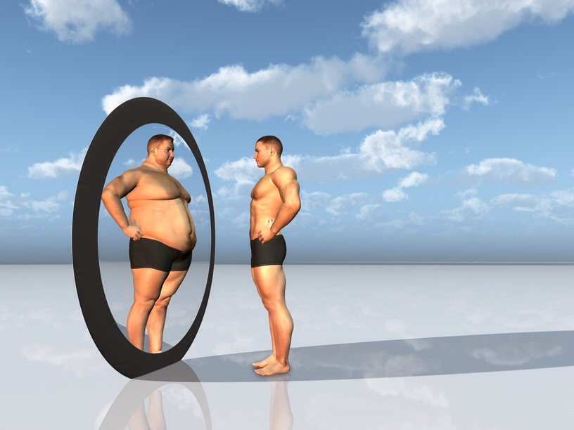
Low Self Esteem

Slide 9
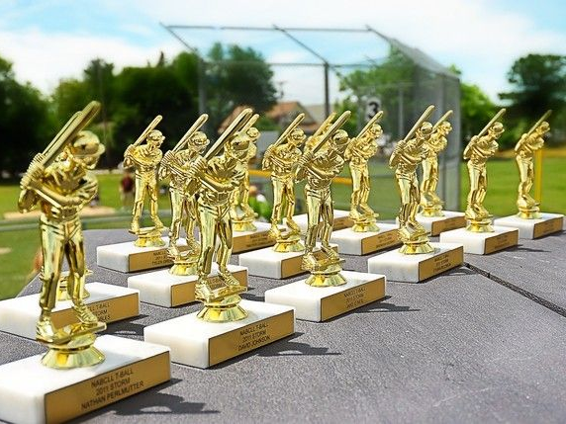
“Everyone gets a trophy.”

Slide 10

Believe in Yourself
我们在基督里的身份

Slide 11
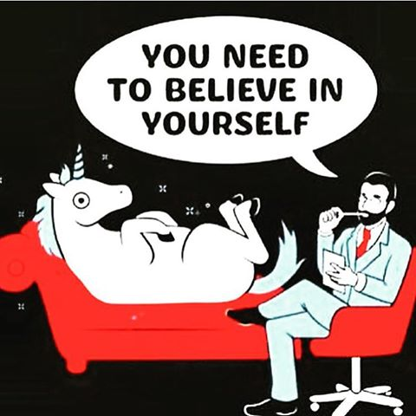
Believe in yourself
我们在基督里的身份

Slide 12
Believe in Yourself
我们在基督里的身份

Slide 13

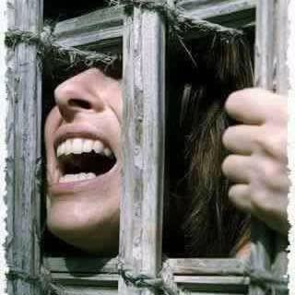
Your Identity in Christ

Slide 14
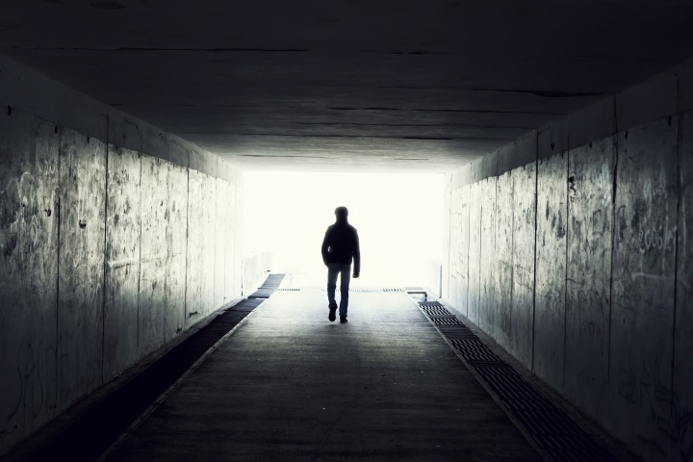
Your Identity in Christ

Slide 15
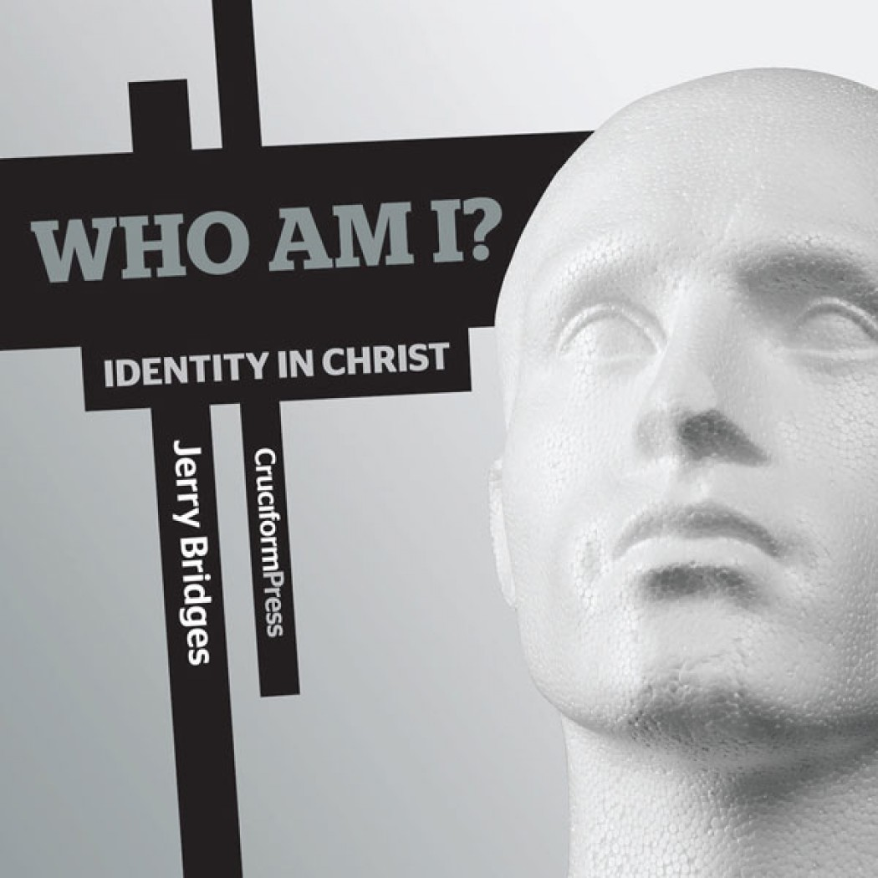
Your Identity in Christ
Who Am I？
Identity in Christ

Slide 16

Our Identity in Christ
The Riches of Grace in Christ Jesus
(33 Divine Accomplishments in and for the Sinner
upon Believing on the Lord Jesus Christ)
by Lewis S. Chafer
Notes:
The Riches of Grace in Christ Jesus
(33 Divine Accomplishments in and for the Sinner upon Believing on the Lord Jesus Christ)
by Lewis S. Chafer
Accessed 9 July 2017
Copied for WholesomeWords.org from Salvation by Lewis Sperry Chafer. Philadelphia: Sunday School Times Company, ©1917.
http://www.wholesomewords.org/etexts/chafer/saved.html

Slide 17

Our Identity in Christ
In the Eternal Plan of God
Reconciled
Redeemed
Related to God Through a Propitiation (the satisfaction of God's holiness)
All Sins Covered by Atoning Blood
Vitally Joined together with Christ for Judgment of the "Old Man" Unto a New Walk
Free from the Law
Children of God
Adopted (placed as adult sons)
Acceptable to God by Jesus Christ
Notes:
The Riches of Grace in Christ Jesus
(33 Divine Accomplishments in and for the Sinner
upon Believing on the Lord Jesus Christ)
by Lewis S. Chafer
Accessed 9 July 2017
Copied for WholesomeWords.org from Salvation by Lewis Sperry Chafer. Philadelphia: Sunday School Times Company, ©1917.
http://www.wholesomewords.org/etexts/chafer/saved.html

Slide 18
Our Identity in Christ
Justified
Forgiven All Trespass
Made Nigh (Drawn Near)
Delivered from the Powers of Darkness
Translated into the Kingdom
On the Rock Christ Jesus
A Gift from God the Father to Christ
Circumcised in Christ
Partakers of the Holy and Royal Priesthood
A Chosen Generation and a Peculiar People
Having Access to God
Within the "Much More" Care of God
Notes:
The Riches of Grace in Christ Jesus
(33 Divine Accomplishments in and for the Sinner
upon Believing on the Lord Jesus Christ)
by Lewis S. Chafer
Accessed 9 July 2017
Copied for WholesomeWords.org from Salvation by Lewis Sperry Chafer. Philadelphia: Sunday School Times Company, ©1917.
http://www.wholesomewords.org/etexts/chafer/saved.html

Slide 19
Our Identity in Christ
His Inheritance
Our Inheritance
A Heavenly Association
Heavenly Citizens
Of the Family and Household of God
Light in the Lord
Vitally United to the Father, Son, and Spirit
Blessed with the "First-Fruits" and the "Earnest" of the Spirit
Glorified
Complete in Him
Possessing Every Spiritual Blessing
Notes:
The Riches of Grace in Christ Jesus
(33 Divine Accomplishments in and for the Sinner
upon Believing on the Lord Jesus Christ)
by Lewis S. Chafer
Accessed 9 July 2017
Copied for WholesomeWords.org from Salvation by Lewis Sperry Chafer. Philadelphia: Sunday School Times Company, ©1917.
http://www.wholesomewords.org/etexts/chafer/saved.html

Slide 20
Romans 5
Righteousness through imputation gives assurance

Slide 21

Righteousness in Romans
145
Theme | Needed | Provided | Imparted | Proved | Applied | Dissem-inated
Intro 1:1-17 | Condem-nation 1:18– 3:20 | Justifi-cation 3:21– 5:21 | Sanctifi-cation 6–8 | Election 9–11 | Trans-form-ation 12:1– 15:13 | Propa-gation 15:14– 16:27
Start | Sin | Salva-tion | Set Apart | Sove-reignty | Service | Send

Slide 22

Romans 5:1
153
A VERSE TO REMEMBER
"Therefore, since we have been made right in God's sight by faith, we have peace with God because of what Jesus Christ our Lord has done for us"

Slide 23
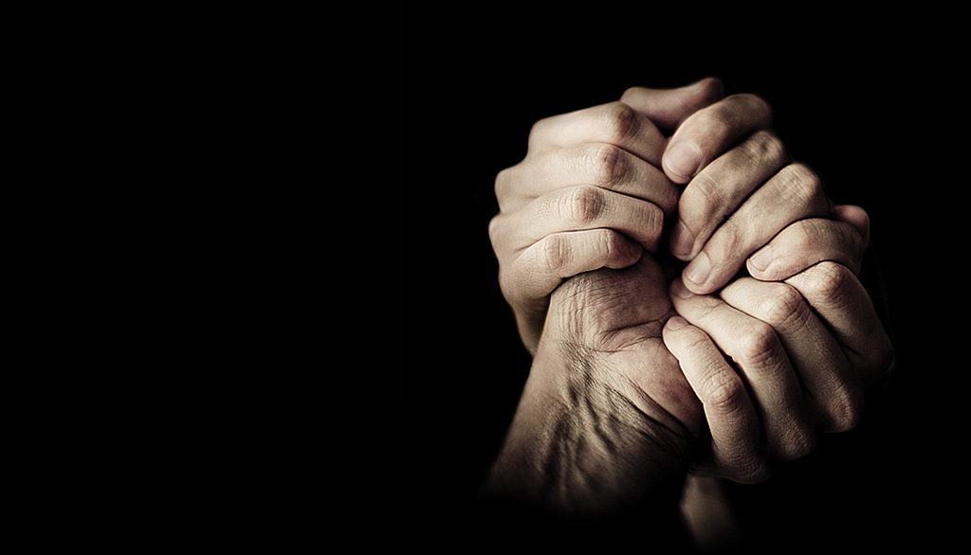
When did death come into the world?
Small Group Question:
Did death exist before the Fall?

Slide 24
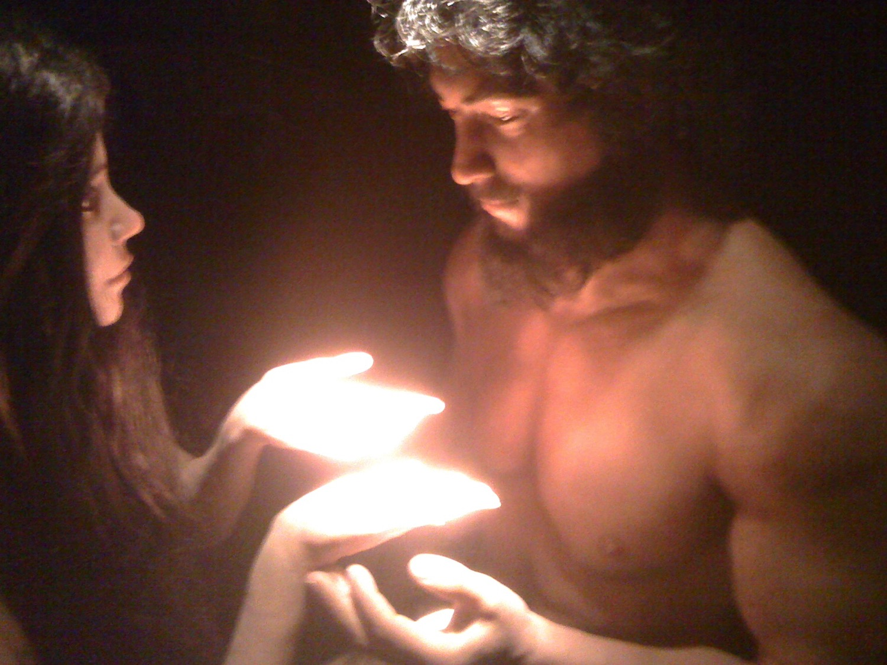
Romans 5:12
Therefore, just as through one man sin entered into the world, and death through sin, and so death spread to all men, because all sinned (NAU)

Slide 25
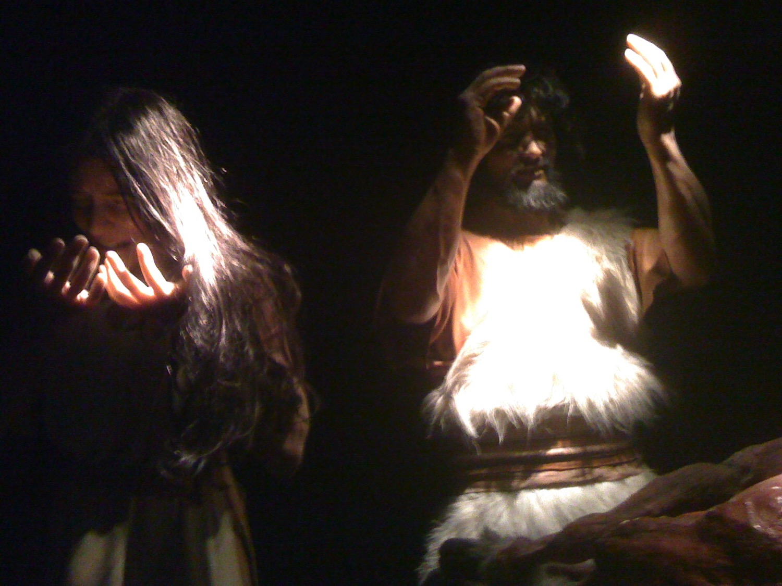
Romans 5:12
When Adam sinned, sin entered the world. Adam's sin brought death, so death spread to everyone, for everyone sinned (NLT)

Slide 26
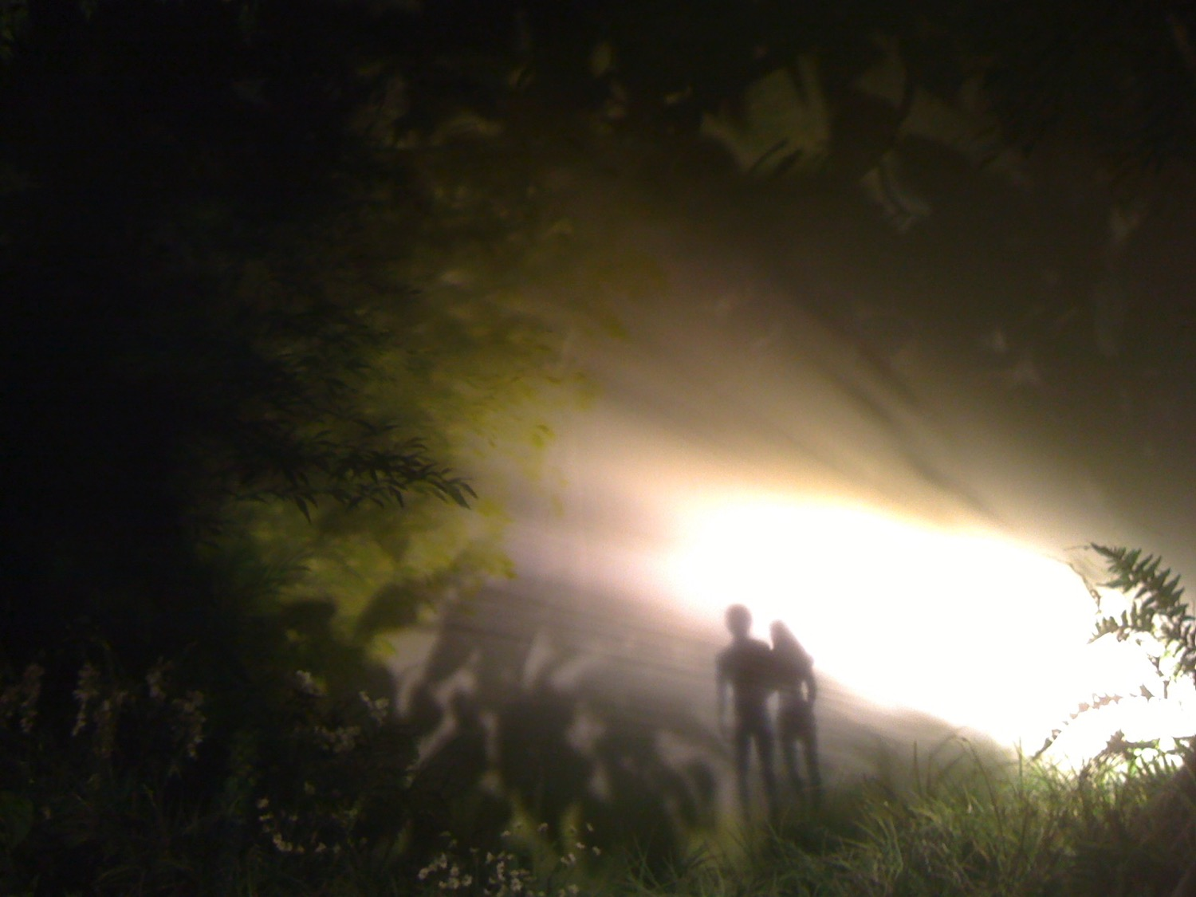
Results of Sin
Shame: "Then the eyes of both of them were opened, and they knew that they were naked; and they sewed fig leaves together and made themselves loin coverings"
(Gen. 3:7; cf. 2:25 NAU)
Separation from God: Adam hid in the Garden (Gen. 3:8)
Death: "In the day you eat from it,
you shall die" (Gen. 2:17 NAU)

Slide 27
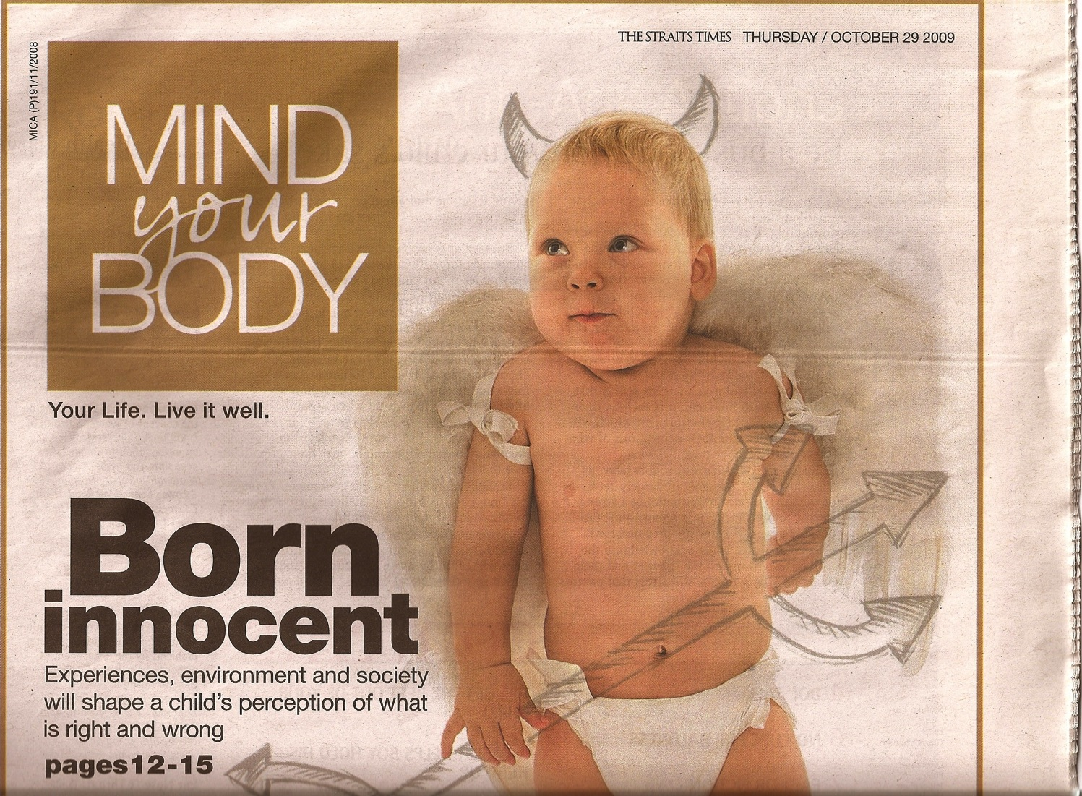
Born Innocent?
Many psychologists believe so!
Born
innocent
Experiences, environment and society will shape a child's perception of what is right and wrong

Slide 28
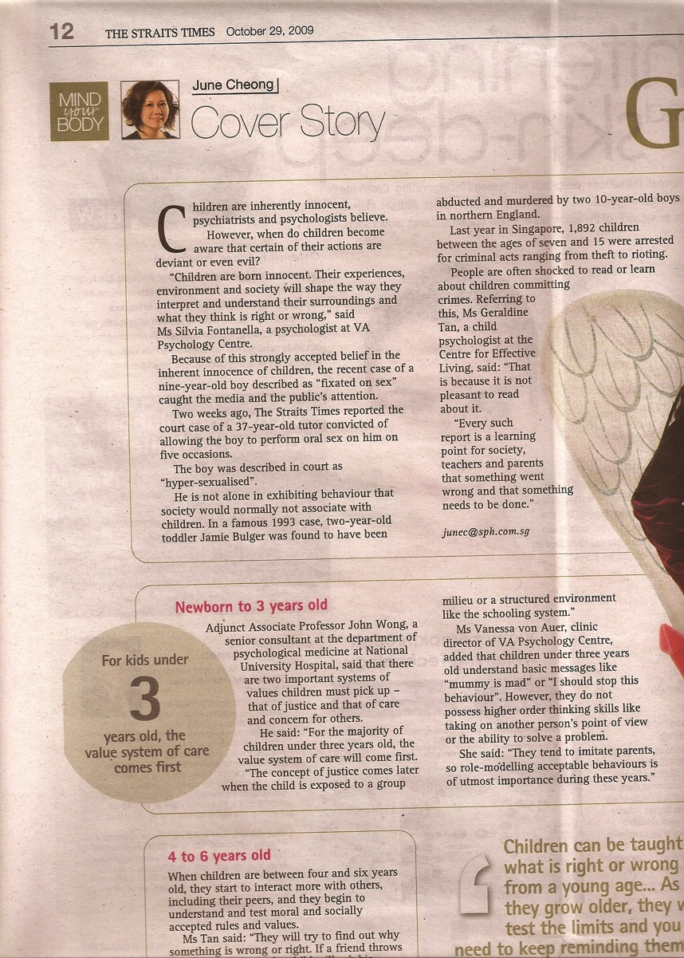
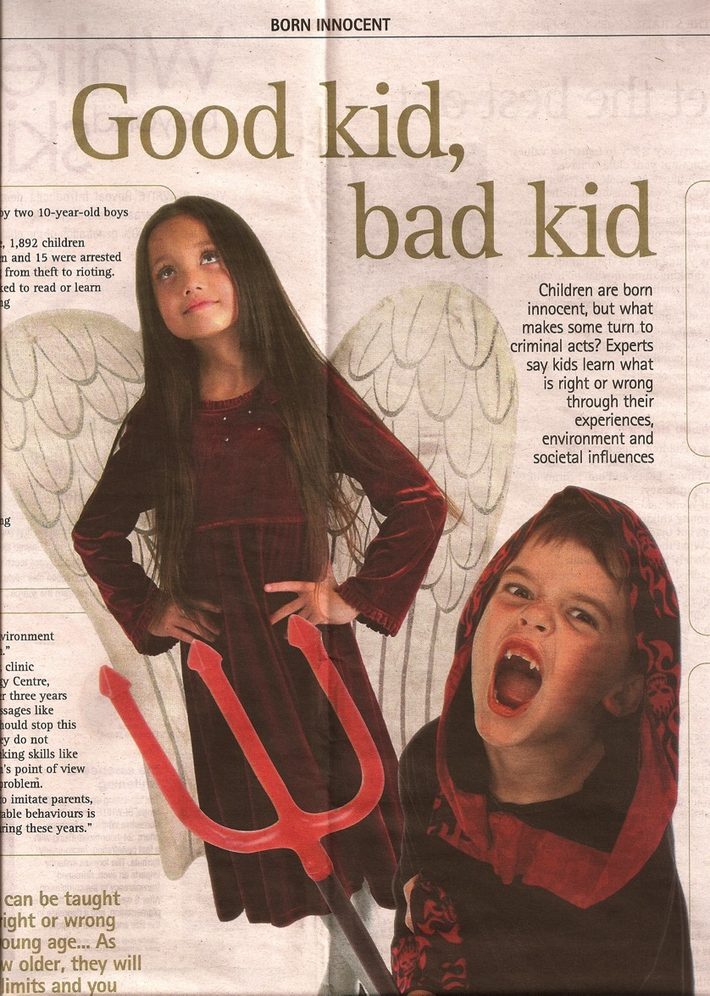
Born Innocent?
Good kid,
Bad kid
The article itself contrasts children (not babies!)
Notes:
Do you see any problems with this theory? To prove that children are born innocent, one cannot evaluate 5-year-olds to see how their environment influenced them. One must show that ALL babies care for their mothers more than themselves! ALL babies care that their mothers get enough sleep, right? ALL babies want to make sure that others are fed before themselves, right? Then later they have to LEARN how to lie, cheat, and steal, right? This theory is not only unbiblical. It is absurd.

Slide 29
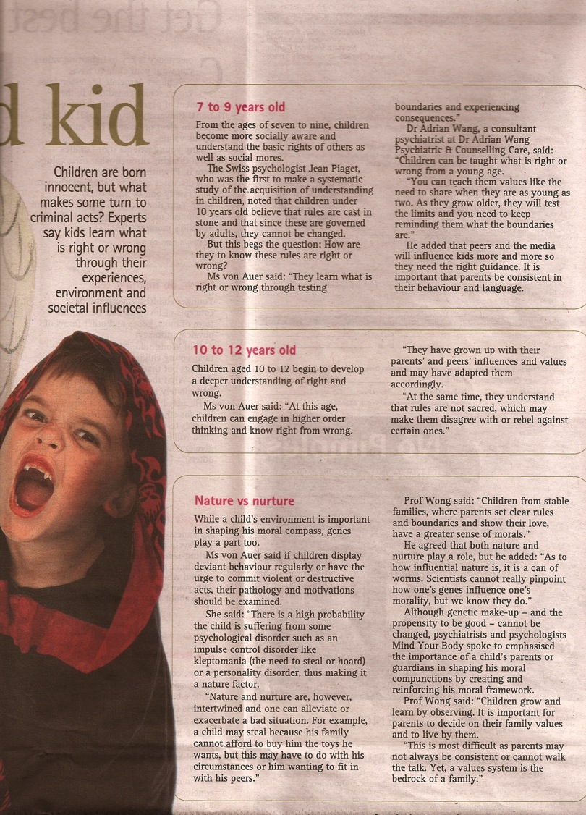
Born Innocent?
The biblical view of original sin fits with what every parent knows.
It also explains why we all must teach children to do right instead of wrong.

Slide 30
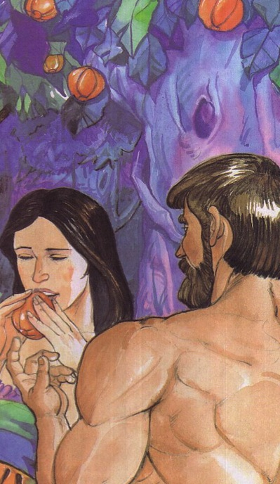
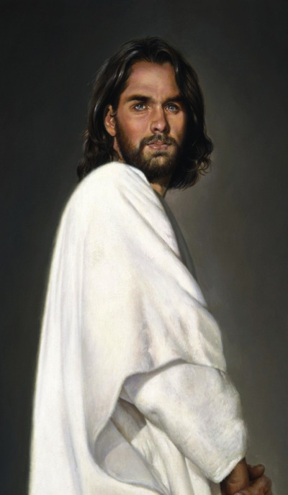
Adam versus Christ
Romans 5:12-21
1 Cor. 15:22
1 Cor. 15:45-49

Slide 31
Romans 5:8-21
33
What we have as Adam's children
What we have as God's children
Adam gave us…
Christ gives us…
Ruin 5:9
Rescue 5:8
Sin 5:12, 15, 21
Righteousness 5:18
Death 5:12, 16, 21
Eternal life 5:17, 21
Separation from God 5:18
Relationship with God 5:11, 19
Disobedience 5:12, 19
Obedience 5:19
Judgment 5:18
Deliverance 5:10, 11
Law 5:20
Grace 5:20

Slide 32
Romans 6
154a
Righteousness is imparted in sanctification through positional identification with Christ

Slide 33
Righteousness in Romans
145
Theme | Needed | Provided | Imparted | Proved | Applied | Dissem-inated
Intro 1:1-17 | Condem-nation 1:18– 3:20 | Justifi-cation 3:21– 5:21 | Sanctifi-cation 6–8 | Election 9–11 | Trans-form-ation 12:1– 15:13 | Propa-gation 15:14– 16:27
Start | Sin | Salva-tion | Set Apart | Sove-reignty | Service | Send

Slide 34
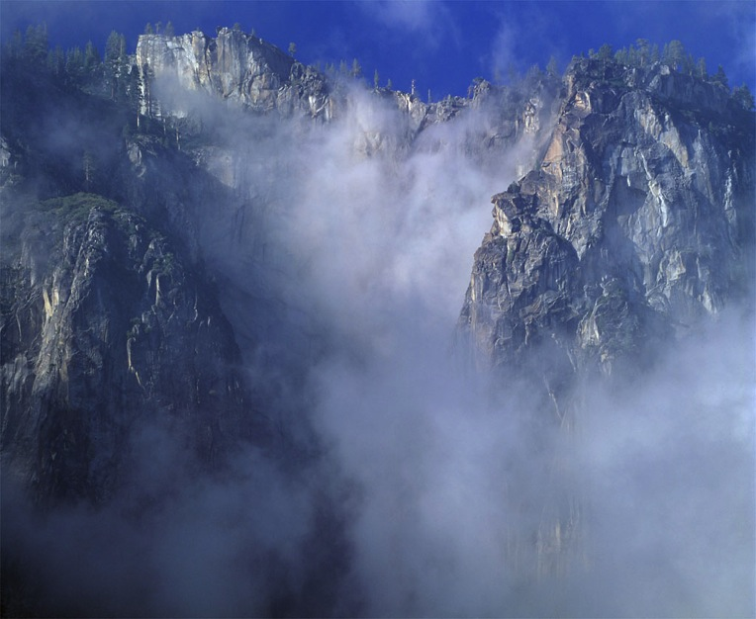
Contrasts Between
Justification and Sanctification
34
155k
JUSTIFICATION
"Not guilty"
Legal Standing
Once for all time
Entirely God's work
Perfect in this life
Same in all Christians
SANCTIFICATION
"Set apart"
Internal condition
Continuous throughout life
We cooperate with God
Not perfect in this life
Different levels

Slide 35
Righteousness Imparted in Sanctification (Rom. 6–8)
33
How does the blood of Christ apply to us?
Chapter 6
New Basis
––
Identification

Slide 36
Righteousness Imparted in Sanctification (Rom. 6–8)
33
How does the blood of Christ apply to us?
"As a wife is no longer married to her husband when he dies, so a Christian is no longer under the Law"
(John A. Witmer, "Romans," in BKC, 2:465).
Chapter 6
New Basis
––
Identification
Chapter 7
New Relationship
––
Freedom

Slide 37
Righteousness Imparted in Sanctification (Rom. 6–8)
33
How does the blood of Christ apply to us?
Chapter 6
New Basis
––
Identification
Chapter 7
New Relationship
––
Freedom
Chapter 8
New Power
––
Spirit

Slide 38

"Shall we go on sinning that grace may increase?"
(Romans 6:1)
154a

Slide 39
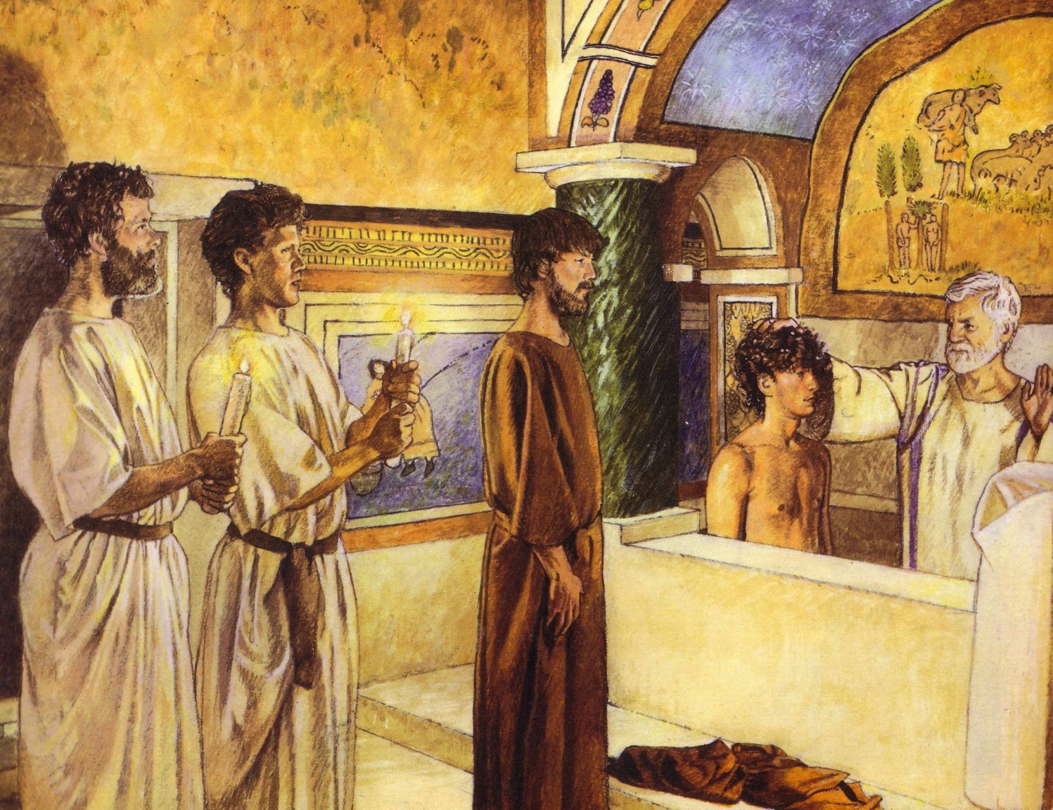
Baptism identifies with His death
154a
For Believers Only
By Immersion Only

Slide 40
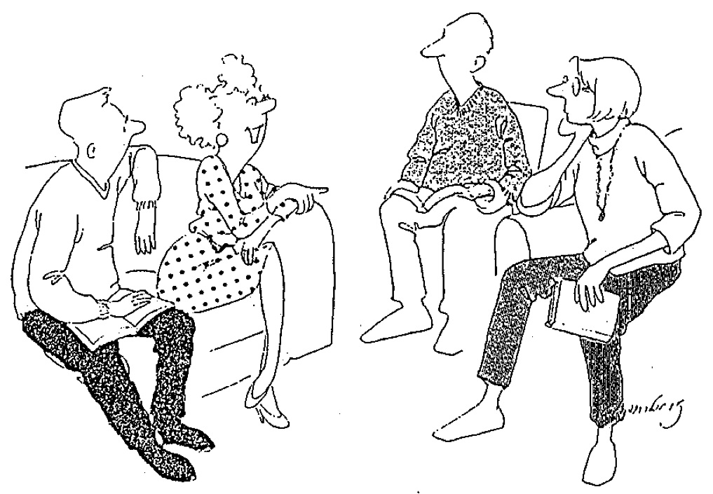
Dying to Sin (6:2)
34
"Well, I haven't exactly DIED to sin,
but I did feel kind of faint once."

Slide 41
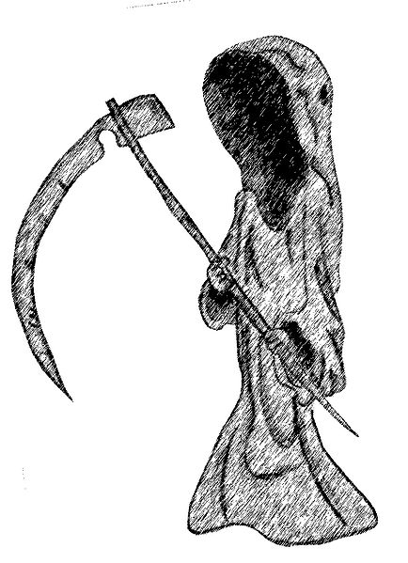
What does it mean that those in Christ have "died to sin" (6:2)?
For your small group…
154a
Christians will never sin again?
Believers never have to sin in a given situation?
A true Christian will never have a pattern of sinning in his life?
Something else? (state it)
Support your answer from Romans 6–7

Slide 42

What Has God Done About Sin?
154
He gave us...
Principles
Importance
New
Life
6:2, 3
6:4
6:6
Sin's power is broken.
Sin-loving nature is buried.
Sin no longer controls you.
Be certain that sin's power is broken.
New
Nature
6:5
6:11
Now you share his new life.
Look at your old self as dead and new self as alive to God.
Be unresponsive to the old power & alive to the new.
New
Freedom
6:12
6:13
6:14
6:16
Do not let sin control you.
Give yourselves fully to God.
You are free.
You can choose your master.
Commit yourself to obey Christ in perfect freedom.

Slide 43



INSTRUMENTS of Righteousness
Romans 6:13
Notes:
Please translate the text at the left and then drag everything over this slide so no English shows. Make sure the fonts remain.

Slide 44
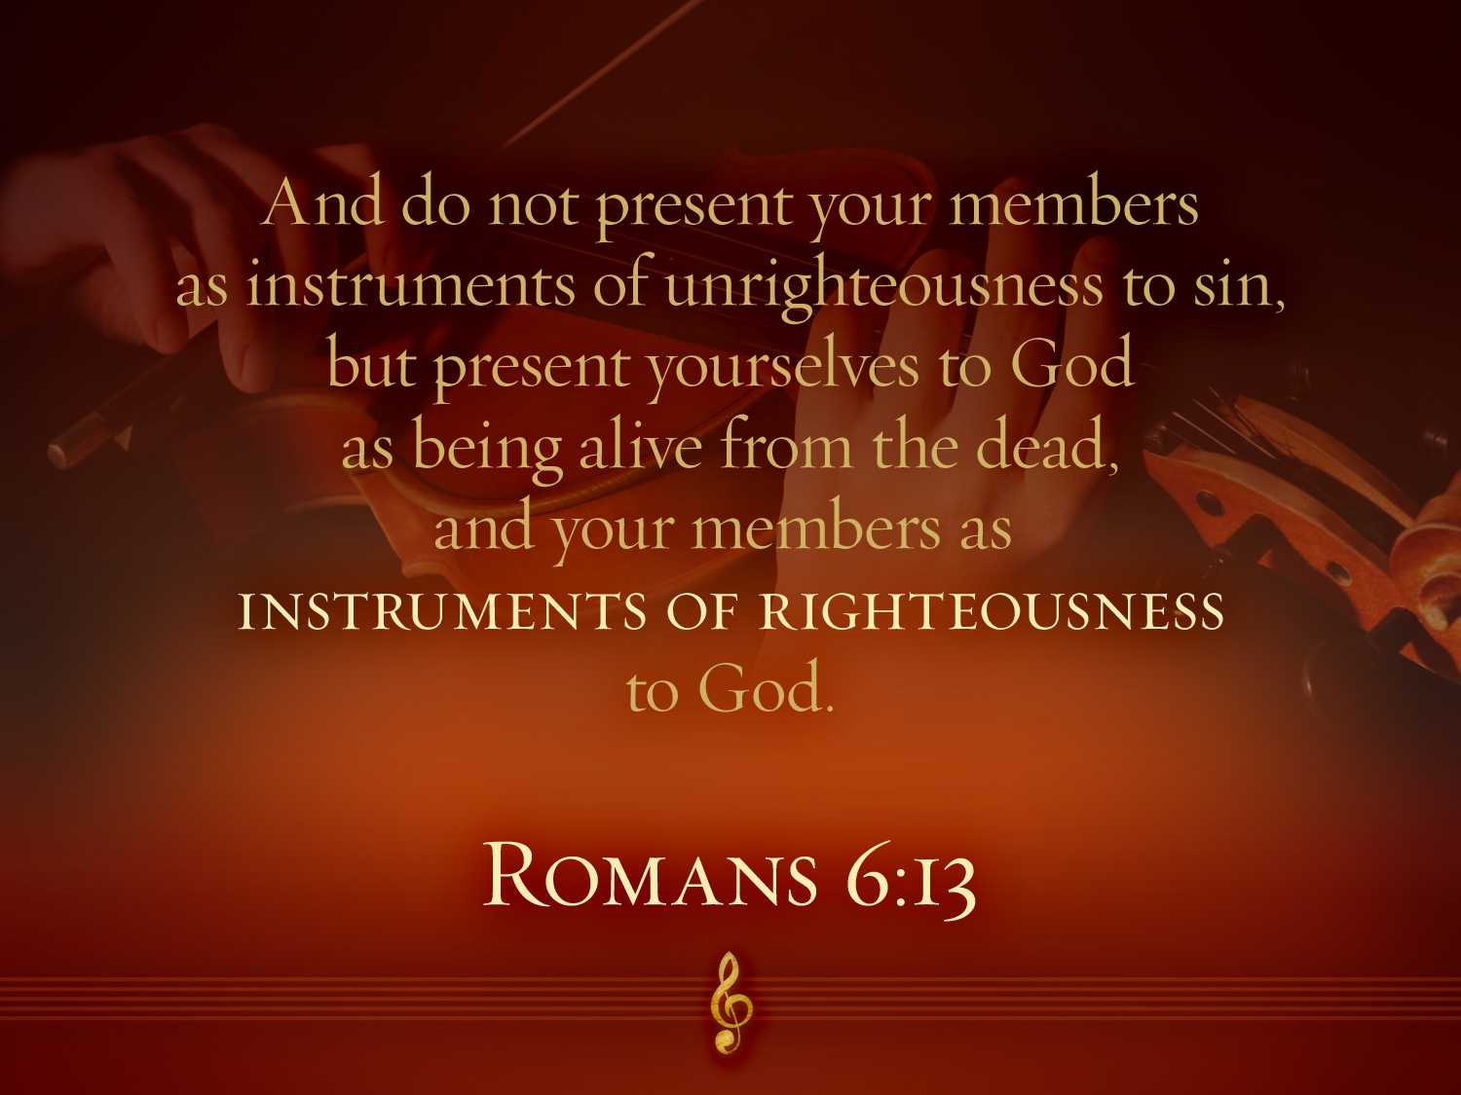

Romans 6:13
"And do not present your members as instruments of unrighteousness to sin, but present yourselves to God as being alive from the dead and your members as INSTRUMENTS OF RIGHTEOUSNESS to God."

Slide 45


No Longer a Slave to Sin
Everyone is a slave but a believer is…
NO LONGER A SLAVE
TO SIN
Romans 6:18
"You have been set free from sin
and have become slaves to righteousness"
Notes:
Please translate the text at the left and then drag everything over this slide so no English shows. Make sure the fonts remain.

Slide 46

What rituals or beliefs do Christians sometimes trust for sanctification instead of their vital experience with Christ (6:2)?
Small Group Exercise
154a
Teaching loss of salvation
Requiring worship styles
Keeping salvation by attending church
Allowing sin if confessed to a priest
Baptism to maintain salvation
The Lord's Supper to maintain salvation

Slide 47
Black

Slide 48


Salvation link at BibleStudyDownloads.org
Get this presentation and script for free!

